Slide 1
Performance Monitoring -
Automated Process Workflow

Slide 2
Course Outline
Performance Monitoring (PerfMon) workflow overview
Present the workflow steps
Notes
Results Interpretation – if time.

Slide 3
PerfMon Workflow Overview
The main steps necessary to create a PerfMon report:
Initiate the PerfMon session
Collect PerfMon results
Analyse the data
Create Report
Estimate system growth (EIM and Sales) – not for customers!

Slide 4
Initiate the PerfMon session
Currently there are two options of running our custom Performance Monitor
Runs once for a 48 hours period
it creates one Baseline file (one .csv file)
it stops automatically after 48 hours
OR,
2. Runs continuously
It creates a new report every 24 hours at 12:00 AM
It never stops
Baseline files older than 30 days are automatically deleted *
For Win2003 requires some editing before the start (Win2003 limitation)

Slide 5
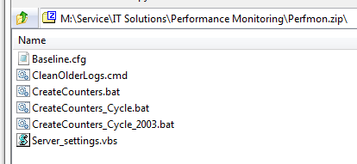
Initiate the PerfMon session (1)
Currently this process is only designed for DB server, although it can be used for the rest of servers (not tested)
Upload the script files onto the server (using FTP, RDP, DropBox etc.) – it is a zip file that contains six files. Place those files into a separate folder
For 48 hours, run (double click) CreateCounters.bat file ONLY!!!
For continuous run, use CreateCounters_Cycle.bat file ONLY!!!
For continuous run Win2003, use CreateCounters_Cycle_2003.bat file ONLY!!! Edit the file first.

Slide 6
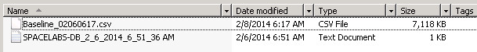
Initiate the PerfMon session (2)
Recommended – verify that PerfMon is running
Browse to C:\PerfLogs\Spacelabs
You should see two files. More files will be created for continuous run version. Check the date if not sure.
Baseline_XXX.csv – most important
HOSTNAME_XXX.txt – contains useful information – can be read immediately
Logout and come back after 48 hours or whenever there is an issue (continuous version)

Slide 7
Collect the PerfMon results (1)
After running it for 48 hours:
On the remote database server, browse to C:\PerfLogs\Spacelabs
Download the .csv files and the .txt file onto your computer (most recent Baseline_XXX.csv’s if using the continuous)
On your computer it is preferable to have a subfolder for each customer account. Place these files in that subfolder.
Copy ProcessResults.xlsm into same subfolder on your computer

Slide 8
Collect the PerfMon results (2)
IMPORTANT!! Before logging out the DB server make sure you know:
Total Number of Monitors and Telemetry Channels connected to ICS
The drive letter for the OS disk (usually is C: )
The drive letter for the database disk (usually is D: )
The drive letter for the Transaction log disk – if any
The drive letter for the TempDB disk - if any
Total system Memory (RAM)
Total number of cores (sockets X cores/processor)
6 and 7 can be found in HOSTNAME_XXX.txt file

Slide 9
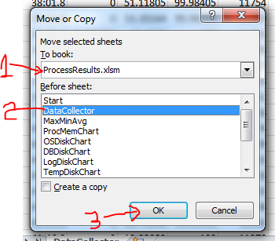
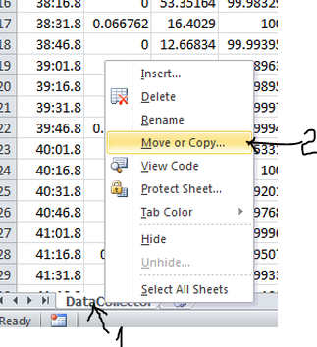
Analyze PerfMon results (1)
On your computer browse into the customer subfolder:
Open ProcessResults.xlsm
Open Baseline_XXX.csv file – you can add multiple Baseline files.
Move the .csv data into the xlsm file:

Slide 10
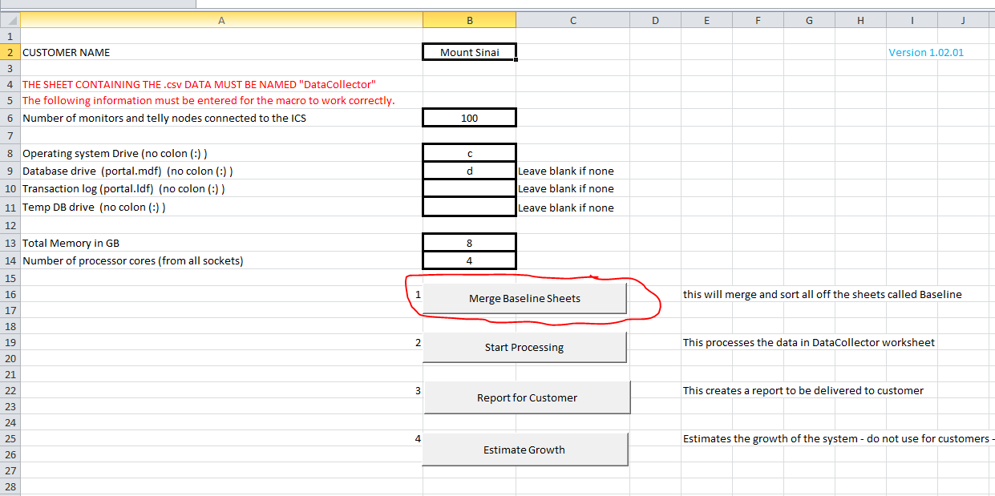
Analyze PerfMon results (2)
In the ProcessResult.xslm click on “Merge Baseline Sheets” button on Start sheet – this moves data from all Baseline sheets into DataCollector sheet.

Slide 11
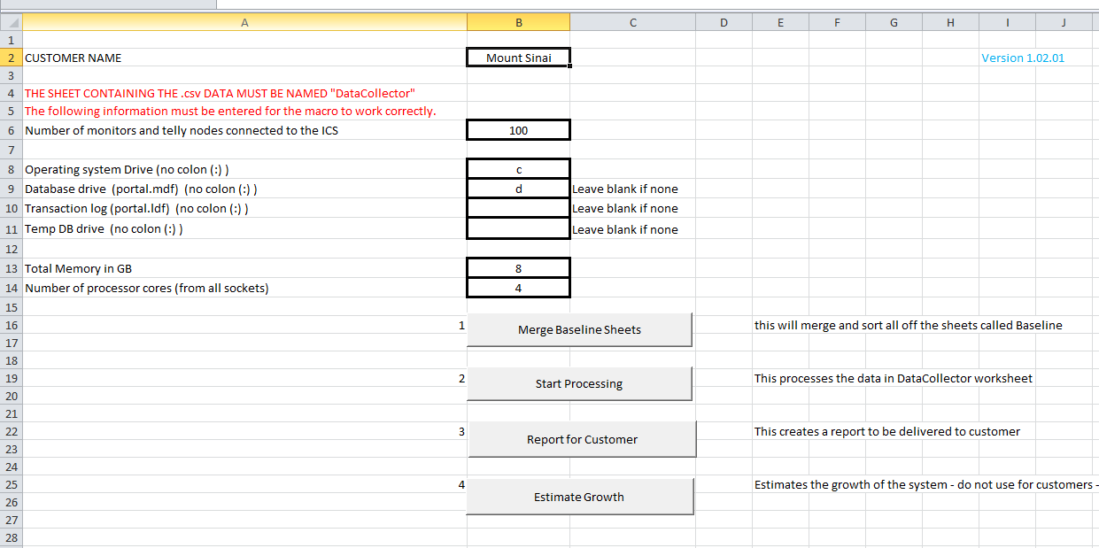
Analyze PerfMon results (3)
In the ProcessResult.xslm go to Start sheet and fill out the fields:

Slide 12
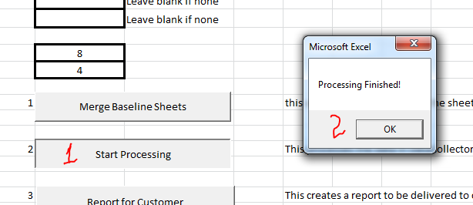
Analyze PerfMon results (4)
Hit Start Processing button and wait for the message that it ended

Slide 13
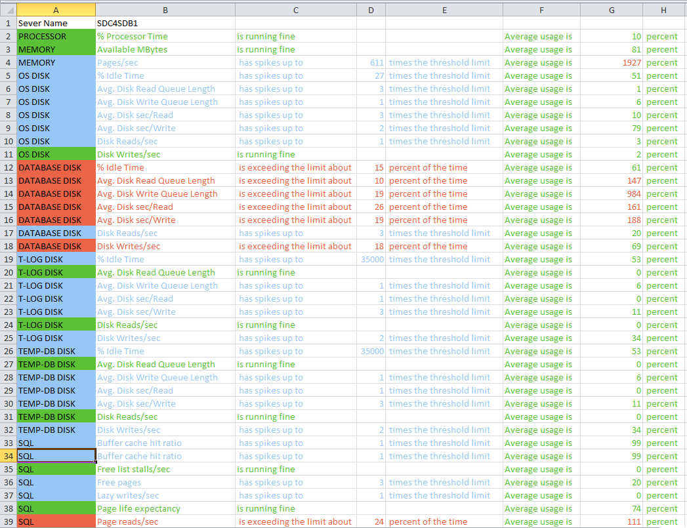
PerfMon results (1)
In the ProcessResult.xslm – Report sheet :
Anything red in there is a potential issue and needs to be investigated.
Red = limit is exceeded more than 10% of the time
Blue = limit is exceeded less than 10% of the time
Green = Limit is never exceeded

Slide 14
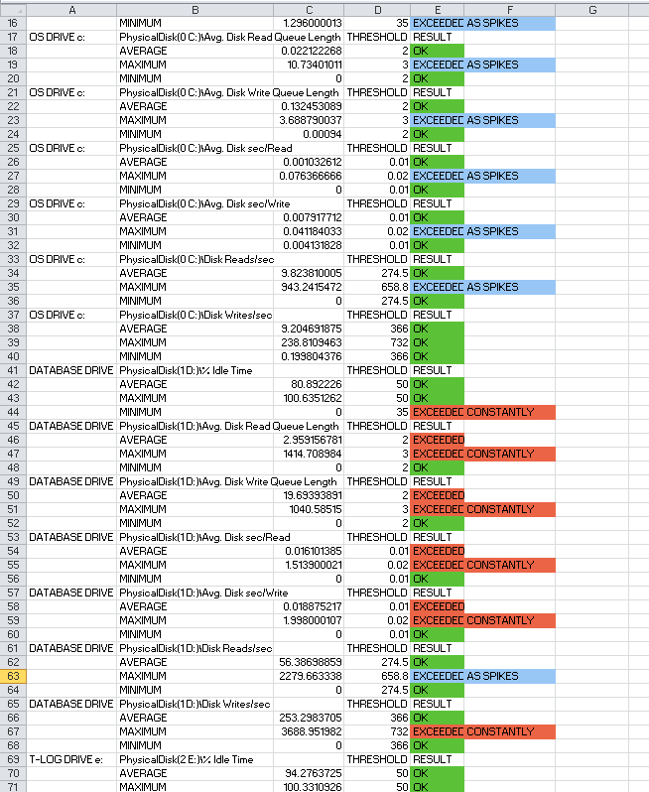
PerfMon results (2)
In the ProcessResult.xslm – MinMaxAvg sheet:
Anything red in there is a potential issue and needs to be investigated.
Red = limit is exceeded more than 10% of the time
Blue = limit is exceeded less than 10% of the time
Green = Limit is never exceeded
Each Counter is compared against the limits defined in the Threshold sheet

Slide 15
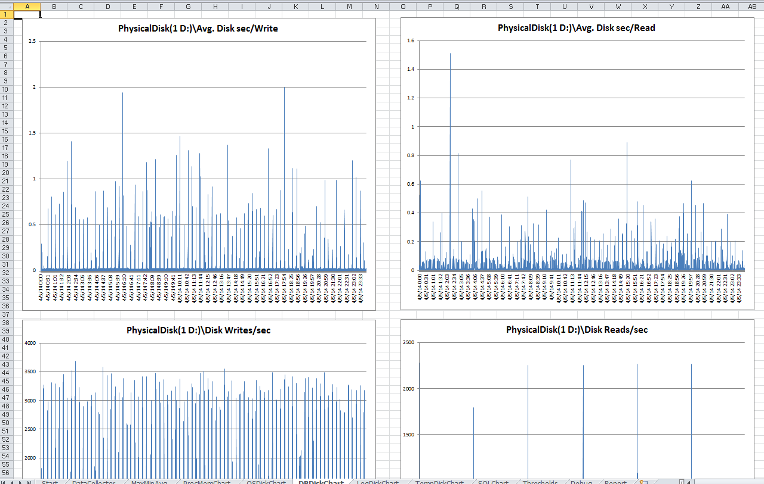
PerfMon results (3)
In the ProcessResult.xslm – XXXChart sheet:
Investigate the distribution of the values.
Check for any patterns
Look for “eye averages”
Check the approximate time when odd events happened

Slide 16
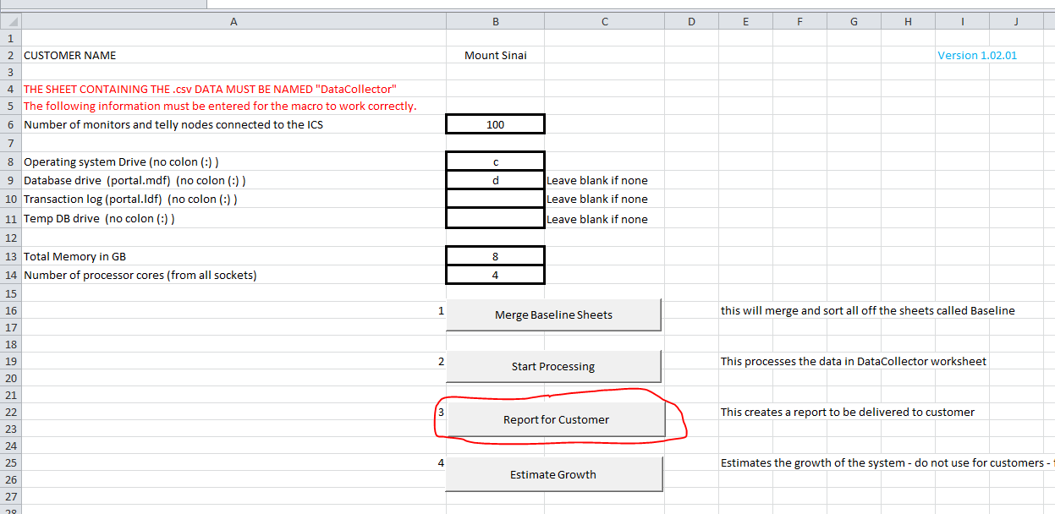
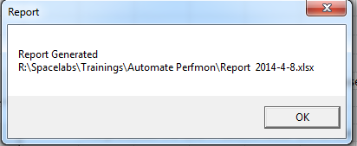
Create Report for Customer (1)
Hit Report for Customer button and wait for the confirmation message.
The Report strips down all the “inside information (code, limits, debug etc.)

Slide 17
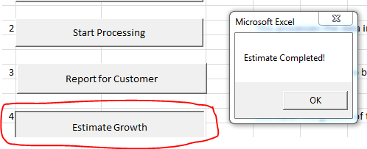


Estimate Growth
Hit Estimate Growth button and wait for the message that it ended.
The two possible lines (orange) added in Report sheet
The routine is intended for EIMs and sales people
It is not a perfect tool – use it with a lot of “salt”
If there is any red cell in column G (Usage) of the Report sheet do not add any more monitors before consulting with a TM or EIM.
The yellow estimate is just an estimate. Never add more than 100 monitors at once regardless of how much that number says

Slide 18
Notes on Report
When reading the report:
Any red line requires further investigations (charts, Min/Max/Avg. sheets)
For VMware, Performance Monitor from within Windows may not be enough. Use also VMware console or esxtop for complete data
All necessary files are located at “M:\Service\IT Solutions\Performance Monitoring” (\\isqdfs02.osient.com)
Q&A

Slide 19
Interpreting the Results

Slide 20
Server Resources Overview
Any server uses four main physical resources:
Processor
Memory
Storage
Network
These resources need to be available and sufficient before any further investigation takes place (software issues, user training etc.).
We can consider SQL as another resource for ICS
SQL

Slide 21
Performance Monitor – Interesting Counters
PROCESSOR
Counter Object Counter Property Counter Instance
Processor %Processor Time _Total
Most familiar (from Task Manager).
Anything more than 50-60 % for a longer time may indicate an issue

Slide 22
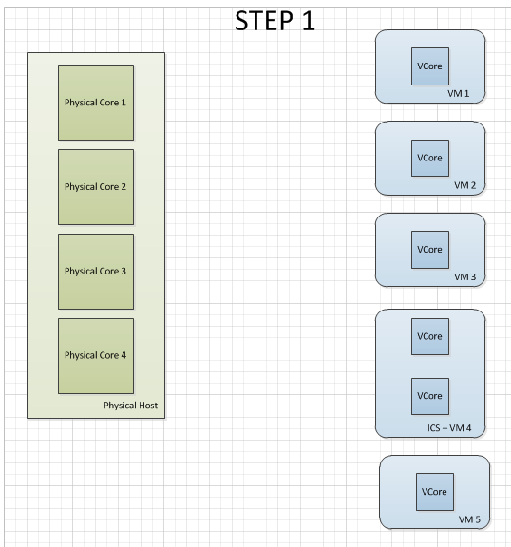
Performance Monitor – Interesting Counters
PROCESSOR – VMware Issue
1 host with 4 Physical Cores
4 VMs with 1 Vcore
ICS VM has 2 VCores

Slide 23
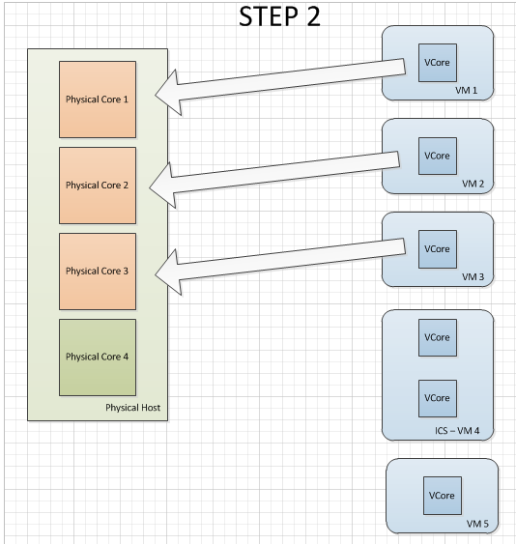
Performance Monitor – Interesting Counters
PROCESSOR – VMware Issue
VM1 – VM3 have to process and occupy the first three VCores

Slide 24
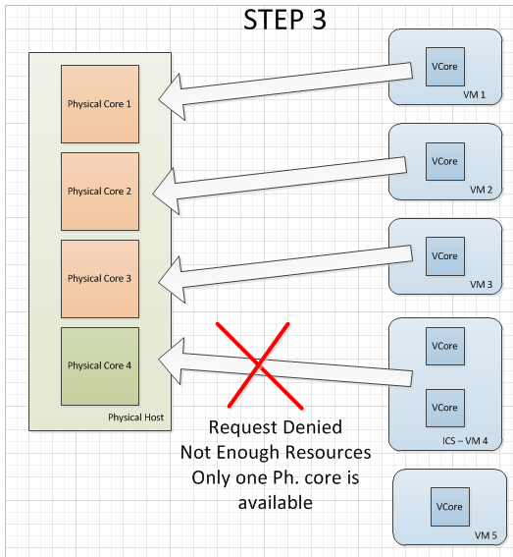
Performance Monitor – Interesting Counters
PROCESSOR – VMware Issue
ICS VM has to process but it has to wait because there is only one Vcore left

Slide 25
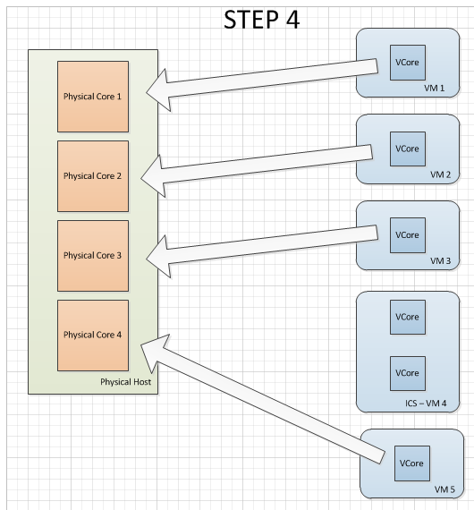
Performance Monitor – Interesting Counters
PROCESSOR – VMware Issue
While ICS VM is waiting for free resources, VM5 has to process and occupies the last free VCore
Now ICS VM has no resources at all

Slide 26
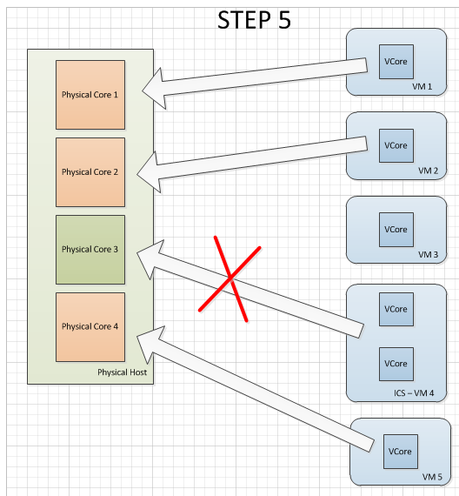
Performance Monitor – Interesting Counters
PROCESSOR – VMware Issue
VM3 is done processing and frees up one Vcore
ICS VM is still unable to process – not enough free VCores

Slide 27
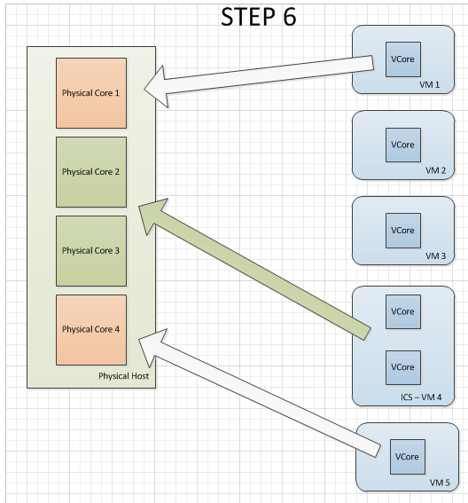
Performance Monitor – Interesting Counters
PROCESSOR – VMware Issue
VM2 is done processing and frees up another Vcore
ICS finally has the resources to process

Slide 28
Performance Monitor – Interesting Counters
PROCESSOR – VMware Issue - Conclusion
Multiple cores for a VM can result in poor performance – not seen from inside Windows (see VMware presentation)
ICS DB Server needs more than one core in order to take advantage of SQL’s multithreading capability
ANSWER:
Set the Virtual Processor Shares to High for the ICS VM in VMware console (customer has to do this). This will increase the priority for this VM against the rest.
Keep the number of ICS’s VCores to half of available Physical Cores.
Create 4 VProcessors with 1Vcore rather than 1 VProcessor with 4 VCores

Slide 29
Performance Monitor – Interesting Counters
MEMORY
Counter Object Counter Property Counter Instance
Memory Pages/sec N/A
Measures how often the system uses the hard-disk instead of memory. More than 5 it may indicate an issue (spike >20)
Counter Object Counter Property Counter Instance
Memory Available Mbytes N/A
Very familiar – indicates if system is lacking in RAM (if gets close to zero) – > 0.5 GB

Slide 30
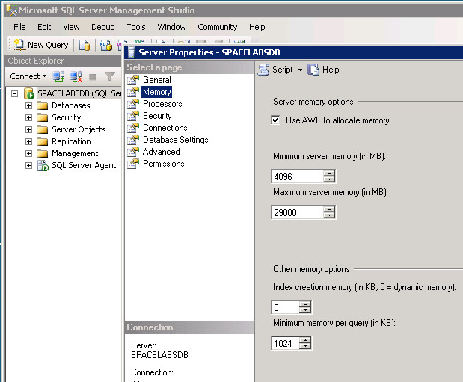
Performance Monitor – Interesting Counters
MEMORY “Gotcha” for over 4GB
Counter Object Counter Property Counter Instance
Memory Available Mbytes N/A
4 GB
29 GB
System
2 GB
~ 1 GB free
SQL
32 GB
Available Mbytes – still 1GB free while SQL is struggling

Slide 31
Performance Monitor – Interesting Counters
STORAGE
Space - generally not an issue as DB is constant in size
Delay/Latency
Counter Object Counter Property Counter Instance
Physical Disk Avg. Disk Sec/Read The disk where the DB is located (D:, E:)
Physical Disk Avg. Disk Sec/Write The disk where the DB is located (D:, E:)
Measures how many seconds (milliseconds) it takes the system to complete ONE Read (Write) operation
<10 ms (spike <20ms)

Slide 32
Performance Monitor – Interesting Counters
STORAGE
Delay/Latency (continued)
Counter Object Counter Property Counter Instance
Physical Disk Avg. Disk Read Queue Length The disk where the DB is located (D:, E:)
Physical Disk Avg. Disk Write Queue Length The disk where the DB is located (D:, E:)
Measures the number of read/write requests that had to be delayed (buffer for the physical disks)
More than 2 (spike 3) indicates a slow hard-disk

Slide 33
Performance Monitor – Interesting Counters
STORAGE
IOPS
Counter Object Counter Property Counter Instance
Physical Disk Disk Reads/sec The disk where the DB is located (D:, E:)
Physical Disk Disk Writes/sec The disk where the DB is located (D:, E:)
Measures the disk utilization
Threshold greatly varies with number of monitors, installed ICS applications (HL7), number of CA users (Analyze)

Slide 34
Performance Monitor – Interesting Counters
SQL
Transactions
Counter Object Counter Property Counter Instance
SQLServer: SQL Statistics Batch Requests/sec
Replaces the Transactions/sec in prior SQL versions
Measures the activity of the SQL Engine
A value above 1000/sec/core (spike 2500) may indicate a SQL engine issue

Slide 35
Performance Monitor – Interesting Counters
SQL
Buffer Activity
Counter Object Counter Property Counter Instance
SQLServer: Buffer Manager Page life expectancy
Similar to Pages/sec for Memory
Measures for how long the system expects a page to reside in memory before is discarded and a new one is read from the disk
A value UNDER 2500 (spike 400) may indicate RAM shortage or a SQL engine issue

Slide 36
Performance Monitor – Interesting Counters
SQL
Buffer Activity (continued)
Counter Object Counter Property Counter Instance
SQLServer: Buffer Manager Page reads/sec
SQLServer: Buffer Manager Page writes/sec
It is the IOPS for SQL (similar to IOPS for Disk)
Measures the number of physical DB page reads/writes issued
A value above 90 may indicate a SQL engine issue

Slide 37
Performance Monitor – Interesting Counters
SQL
Available Memory “Gotcha” – more counters
Counter Object Counter Property Counter Instance
SQLServer: Buffer Manager (1)Lazy Writes/sec
SQLServer: Buffer Manager (2)Free Pages
SQLServer: Buffer Manager (3)Free List Stall/sec
(1) This counter tracks how many times a second that the Lazy Writer process is moving dirty pages from the buffer to disk in order to free up buffer spaceMeasures the number of physical DB page reads/writes issued. It should be under 20/sec (25/sec spike)
(2) Total number of pages on all free lists. Always above 0 (>640 – OK, >800 excellent)
(3) Free list stalls/sec is the frequency with which requests for available database pages are suspended because no buffers are available. Should always be 0 (<2/sec – OK; spike <3/sec)

Slide 38
Interpreting the Results
TIPS:
A high maximum or low minimum may be isolated and not a sign of issues (that’s why charts are useful)
Average values can be your first clue of system performance issues
When you see spikes in charts, look for a pattern – that can indicate a scheduled job (backup) that is consuming resources
Compare related counters for consistency (i.e if Avg. Disk Sec/Write is high, compare with Write Queue Length and Disk Writes/sec) or Memory Pages/sec vs. SQL Page Life Expectancy.
Better interpretation skills come with practice ☺

Slide 39
Performance Monitor – Quiz 1
How is the load on the Processor on this system?
Can you see the pattern?

Slide 40
Performance Monitor – Quiz 2
The threshold for Avg. Disk sec/Write is 10 ms (spike 20 ms)
Is this disk performing properly?

